Slide 1

Go, change the world
RV College of
Engineering
IOTC- Unit3
LPC 2148 Interrupts
Dr K Badari Nath
Department of Computer Science and Engineering
RVCollege Of Engineering
Notes:
<number>

Slide 2

Go, change the world
RV College of
Engineering
As per wiki : “An interrupt is a signal sent to the CPU which indicates that a system event has a occurred which needs immediate attention“. An ‘Interrupt ReQuest‘ i.e an ‘IRQ‘ can be thought of as a special request to the CPU to execute a function(small piece of code) when an interrupt occurs. This function or ‘small piece of code’ is technically called an ‘Interrupt Service Routine‘ or ‘ISR‘. So when an IRQ arrives to the CPU , it stops executing the code current code and start executing the ISR. After the ISR execution has finished the CPU gets back to where it had stopped.
Interrupts in LPC214x are handled by Vectored Interrupt Controller (VIC) (which is specific to ARM based microcontrollers and CPUs) and are classified into 3 types based on the priority levels.

Slide 3
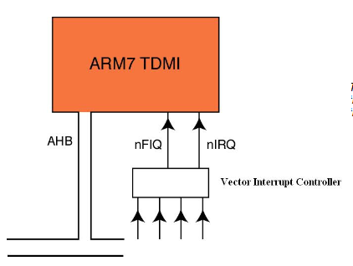
Go, change the world
RV College of
Engineering
VIC present inside the LPC 2148, manages all the interrupts generated from the peripherals present inside the IC and also external interrupts. Each peripheral device has one interrupt line connected to the VIC (but inside the peripheral, several interrupt flags are present representing the different events for the interrupt generation).

Slide 4
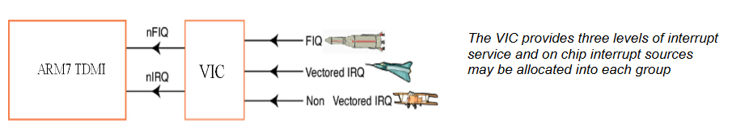
Go, change the world
Types of Interrupts
RV College of
Engineering
VIC receives total 32 interrupt requests from different sources like UART, PWM unit, Timers, USB, EINT0-3 etc and categorizes them as,
FIQ (Fast interrupt request, has the highest priority, serviced first by FIQ handler. If more than one FIQ is occurred, FIQ handler must read the contents of FIQ status register to check the source and initiate the corresponding service routine)
IRQ –Medium priority, Vectored interrupt request ( 16 of the total 32 interrupts can be assigned to IRQ, referred as IRQ slots, 0 to 15, with slot0 having the highest priority, and slot15 has the lowest, every slot is provided with two registers, namely VICVectAddr and VICVectCntl to specify the slots interrupt vector and enable the slot, since it is vectored. Programmer has to map the peripheral i.e interrupt source to the slot, using the above registers.
c) Non-vectored IRQ – Lower priority ( interrupt vector, in this case is common for all non-vectored IRQs, and is to loaded into the register VICDefVectAddr )
The VIC generates FIQ signal combining all the FIQ interrupt requests and combines the requests from all the vectored and non-vectored IRQ’s to produce IRQ signal to the ARM processor.
FIQ is serviced first, if no FIQ then IRQ related to Vectored interrupts is serviced, based on the priority assignment (IRQ0 highest, IRQ15 lowest), if no vectored interrupt request, then non-vectored IRQ is generated.

Slide 5
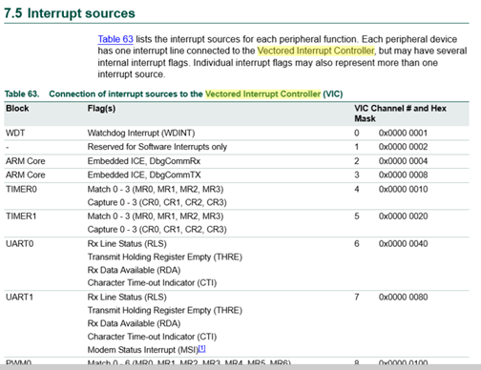
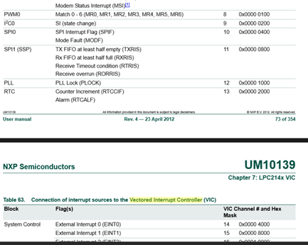
Go, change the world
Interrupts Sources
RV College of
Engineering
FIQ is serviced first, if no FIQ then IRQ related to Vectored interrupts is serviced, based on the priority assignment (IRQ0 highest, IRQ15 lowest), if no vectored interrupt request, then non-vectored IRQ is generated.

Slide 6
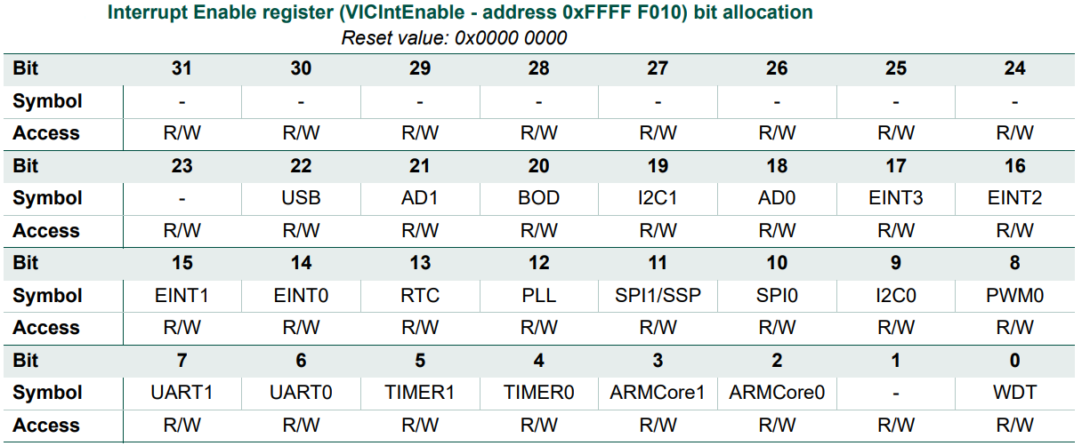
Go, change the world
RV College of
Engineering
Interrupt Enable Register

Slide 7
Go, change the world
RV College of
Engineering
VIC Registers
VICIntEnable : (Interrupt Enable Register): This register controls which of the 32 interrupt requests and software interrupts are enabled to contribute to FIQ or IRQ. This register used to Enable/ disable interrupts coming from different sources.
Ex: to enable timer0 interrupt - VICIntEnable = 0x0000 0010 ; bit D4 corresponds to Timer0
VICIntSelect : (Interrupt Select Register) :This register classifies each of the 32 interrupt requests as contributing to FIQ or IRQ. This register used to classify interrupt as FIQ or IRQ , by default all are IRQ. (Selection of vectored IRQ or non-vectored IRQ, that depends on the programmer using IRQ slots or not, as explained in the below section)
VICVectCntl0-15 : Vector Control Registers 0-15 each control one of the 16 vectored IRQ slots. Slot0 has the highest priority and slot15 has the lowest priority.
Vector Control registers used to map peripheral to IRQ slot and enable it, let us map timer0 to slot 4
VICCntl4 = 0x0000 0024
(D31…………………D5 .D4 D3 D2 D1 D0) D4 to D0 used to indicate the peripheral,
1 0 0 1 0 0 D5 to enable the channel
VICVectAddr0 – 15: Vector Address Registers, used to hold interrupt vector corresponding to slot,
VICVectAddr4 = (unsigned long) Timer0_isr; // Timer0_isr is the isr function
VICectAddr0 to VICVectAddr15: (Vector Address Registers, 16 in number): Vector Address Registers 0-15 hold the addresses of the ISRs for the 16 vectored IRQ slots.
VICVectAddr: (Vector Address Register): When an IRQ interrupt occurs, the IRQ service routine can read this register and jump to the value read.
VICDefVectAddr: (Default Vector Address Register): This register holds the address of the ISR for non-vectored IRQs.

Slide 8
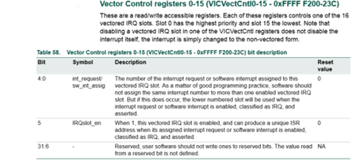
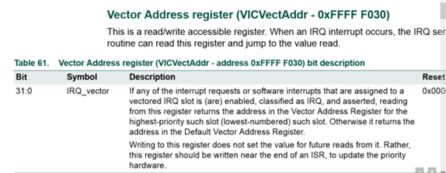
Go, change the world
RV College of
Engineering
VIC Registers

Slide 9
Go, change the world
RV College of
Engineering
Using timer0 and interrupts (ISR) generate the 50Hz waveform on P1.16 (Assume PCLK is 15MHz)
Count calculation:
50Hz means, T = 1/50Hz, = 20msec, hence Ton=Toff = 10mesec
Count to be loaded in MR0 = 10msec/(1/15Mhz) = 1,50,000
#include <LPC2148x.h>
unsigned int x=0;
__irq void Timer0_ISR(void) // an ISR program
{
x = x ^ 1;
if (x)
I0SET1 = 1 << 16; //P0.16 = 1
else
I0CLR1 = 1 <<16; // P0.16 = 0
T0IR = 0x01; // clear match0 interrupt, and get ready for the next interrupt
VICVectAddr = 0x00000000 ; //End of interrupt
}

Slide 10
Go, change the world
RV College of
Engineering
int main(void)
{
I0DIR1 = 0x0001 0000; //set P1.16 as output
T0TCR = 0x00; // stop the timer, to initialize different registers
T0MCR= 0x0003; // Enable Interrupt and reset timer after match
T0TC = 0x00; // make TC = 0
T0MR0 = 150000; // generates 10ms
//load interrupt related registers , assigning Timer0 to IRQ slot 4
VICVectAdd4 = (unsigned long)Timer0_ISR; // set the timer ISR vector address
VICVectCntl4 = 0x0000024; // set the channel
VICIntEnable = 0x0000010; // enable the timer0 interrupt
T0TCR = 0x01; // start the timer
while(1)
{
//do other works
}; // now timer interrupt is serviced automatically using the ISR
}

Slide 11
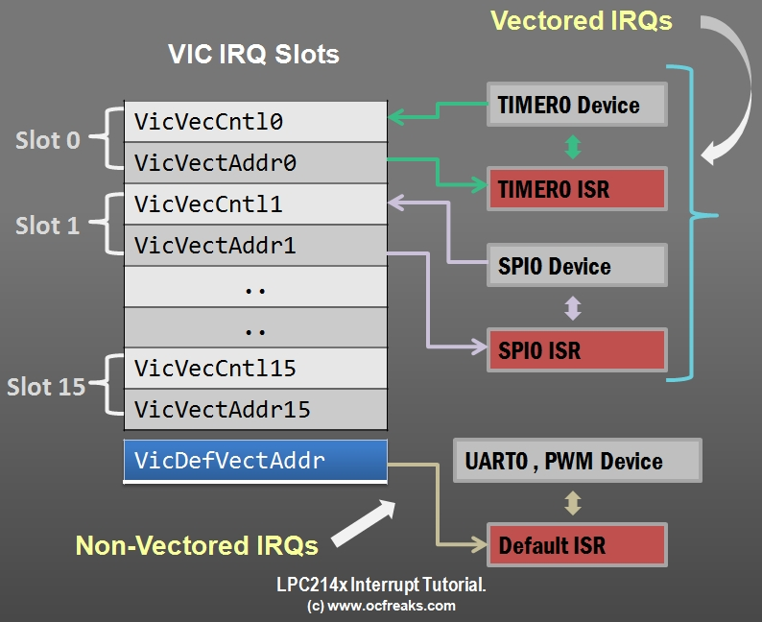
Go, change the world
RV College of
Engineering
http://www.ocfreaks.com/lpc2148-interrupt-tutorial/

Slide 12
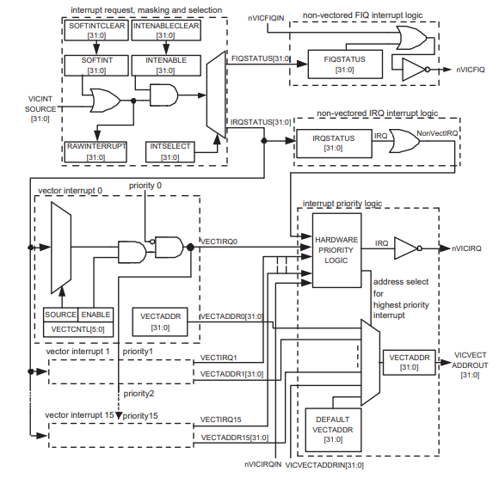
Go, change the world
RV College of
Engineering
Not in Syllabus
Block Diagram
Of VIC (EXTRA INFORMATION)

